Slide 1
My portofolio
Everything Start from There.

Slide 2
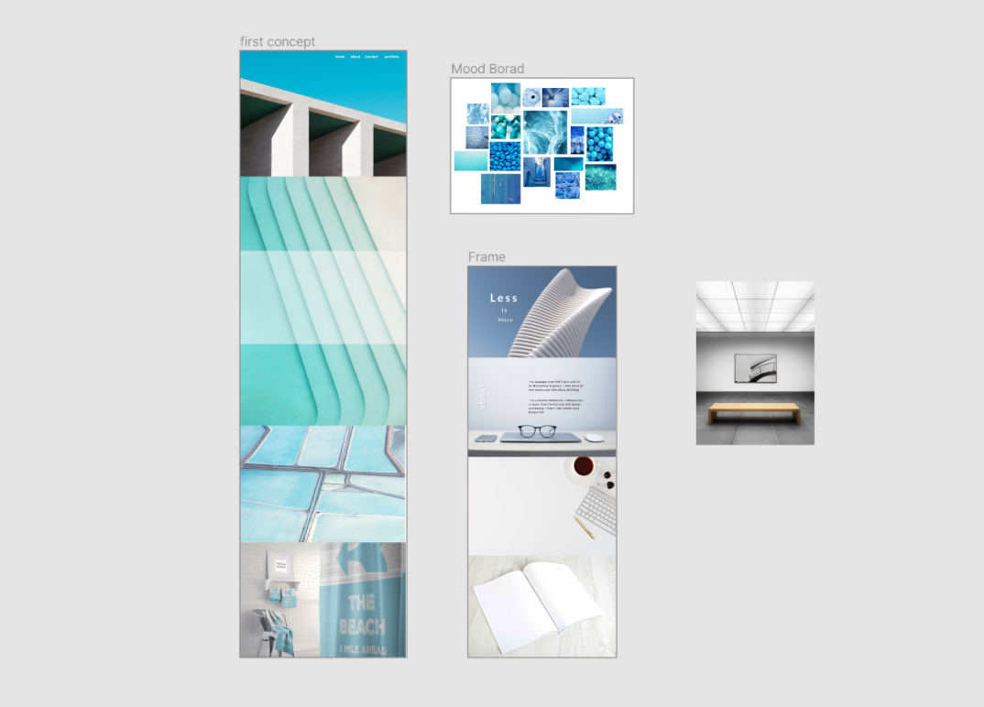
Original Concept

Slide 3
Challenge
Align the background image in the right position
Create grid the align the box
Make the font and box responsive

Slide 4
Future improvement
1. Dropdown background transition
2. Bounce back when scroll
3. Grid Layout when needed
4. Responsible web Layout

